Slide 1
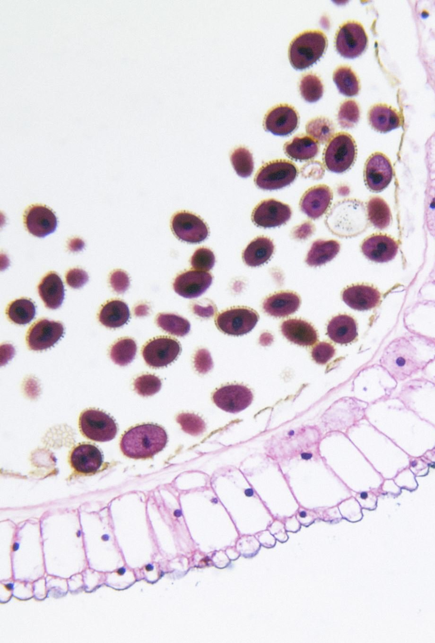
Skin Lesion Classifications using Deep Learning
Name :Vasu Kalariya
Roll No: PE29
Panel: E
Department : (Computer Engineering and Technology)
Programme : T.Y. BTech
Guide Name : Dr. Pradnya Kulkarni

Slide 2
OUTLINE
Introduction & Motivation
Background
Literature Review
Research Gap
Base Paper Explanation
Conclusion
References

Slide 3
INTRODUCTION & MOTIVATION
Skin Cancer is the most common and potentially life-threatening type of cancers.
In 2019, It was diagnosed in about 5.6 million individuals.
It affects 2.5 million people annually in countries such as Australia, New Zealand, South Africa and the US
The estimated 5-year survival rate is over 95% for early stage diagnosis
The estimated survival rate is below 20% for late stage detection.

Slide 4
BACKGROUND
Skin has three layers : The epidermis, The dermis, The Hypodermis
Skin Cancer is the abnormal growth of cells in the dermis or epidermis that has the ability to spread to certain parts of the human body
Skin lesions are broadly classified into Malignant and Benign.
Benign Skin lesions :
Actinic keratoses.
Benign keratosis-like lesions.
Dermatofibroma.
Melanocytic nevi
Vascular lesions.
Malignant skin lesions :
Non-melanoma Skin Cancer
Melanoma Skin Cancer

Slide 5
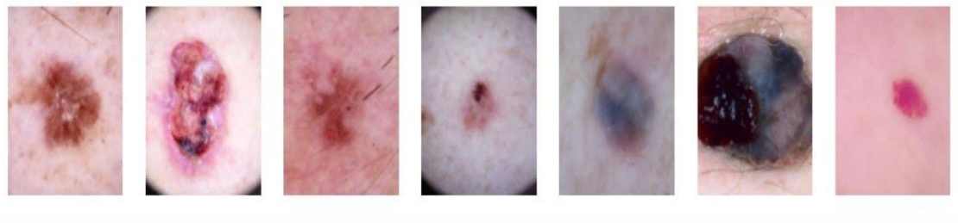
Skin Lesions
Types of Skin Lesions: Actinic Keratoses, Basal Cell Carcinoma, Benign Keratosis-like lesions, Dermatofibroma, Melanocytic Nevi, Melanoma and Vascular Lesions

Slide 6
LITERATURE REVIEW
Sr No | Title of the paper | Author | Year of publication | Dataset used | Methods used | Accuracy | Research Gap
1. | Skin lesion classification using GAN based data augmentation | Haroon Rashid, M Asjid Tanveer, Hassan Aqeel Khan | 2019 (IEEE) | International Skin Imaging Collaboration 2018 | Generative Adversarial Networks (GANs) | 86% | Architecture can be more customized for data generation and classification
2. | SKIN LESION CLASSIFICATION USING HYBRID DEEP NEURAL NETWORKS | Amirreza Mahbod, Gerald Schaefer, Chunliang Wang, Rupert Ecker, Isabella Ellinger. | 2019 (IEEE) | International Skin Imaging Collaboration 2016, 2017 | Convolutional Neural Networks (CNNs) | 90.69 % | Extending the model to incorporate more advanced pre-trained models such as DenseNets could improved classification performance

Slide 7
LITERATURE REVIEW
Sr No | Title of the paper | Author | Year of publication | Dataset used | Methods used | Accuracy | Research Gap
3. | Skin Lesion Classification using Deep Learning and Image Processing | Atharva Jibhakate, Pranav Parnerkar, Sahil Mondal, Vastav Bharambe, Shamla Mantri | 2021 (IEEE) | Skin Cancer MNIST: HAM10000 | ConvolutionalNeural Networks (CNNs), Transfer learning | 99% | Novelness is minimised as the authors have relied more on the transfer learning approach and used pretrained architectures.
4. | Attention Residual Learning for Skin Lesion Classification | Jianpeng Zhang, Yutong Xie, Yong Xia, Chunhua Shen | 2019 (IEEE) | ISIC-skin 2017 | Attention Residual Learning | 91.7% | Lesions are classified only into two types cancerous and non-cancerous

Slide 8
LITERATURE REVIEW
Sr No | Title of the paper | Author | Year of publication | Datasets used | Methods used | Accuracy | Research Gap
5. | FCN-Based DenseNet Framework for Automated Detection and Classification of Skin Lesions in Dermoscopy Images | ADEKANMI A. ADEGUN, SERESTINA VIRIRI | 2020 (IEEE) | HAM10000 | Fully Convolution Network (FCN) | 98% | The encoder-decoder network has less accuracy compared to integrated with the CRF model

Slide 9
RESEARCH GAP
Extending the model to incorporate more advanced pre-trained models such as DenseNets could improved classification performance
Novelness is minimised as the authors have relied more on the transfer learning approach and used pretrained architectures.
The classifier performance can be improved with more number images
Lesions are classified only into two types cancerous and non-cancerous
The encoder-decoder network has less accuracy compared to integrated with the CRF model

Slide 10
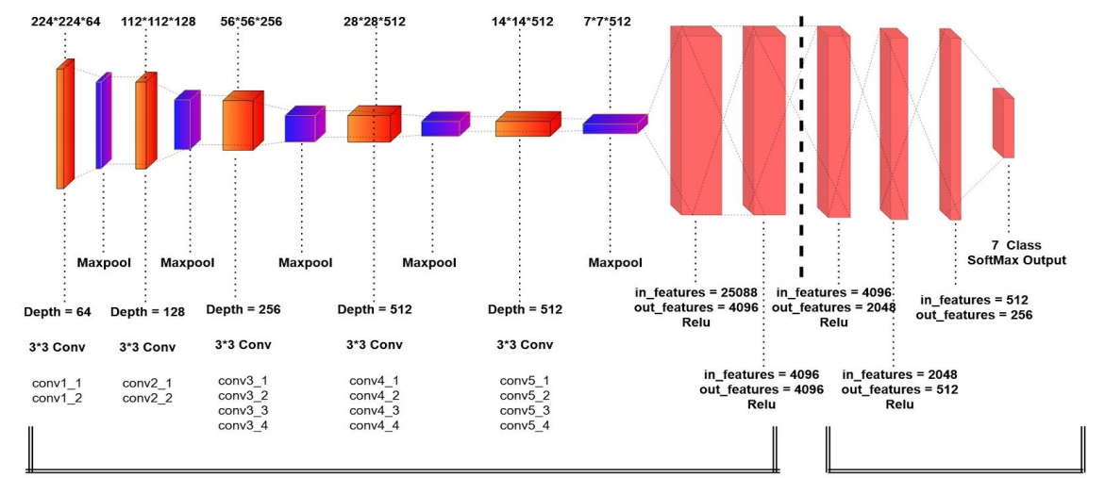
BASE PAPER DETAILS
Paper Name : Skin Lesion Classification using Deep Learning and Image Processing.
Published in : 2020 3rd International Conference on Intelligent Sustainable Systems (ICISS)
Dataset : Skin Cancer MNIST: HAM10000.
Network Architecture :

Slide 11
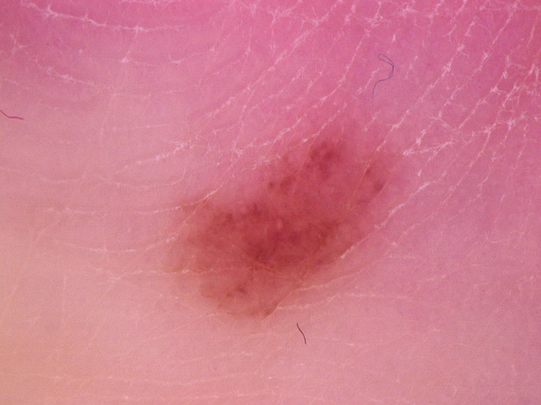
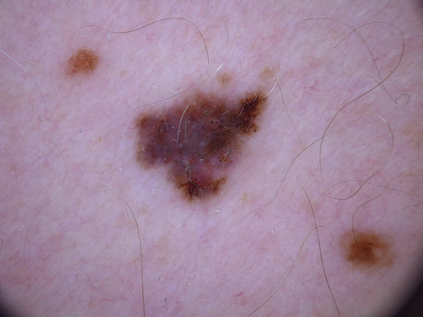
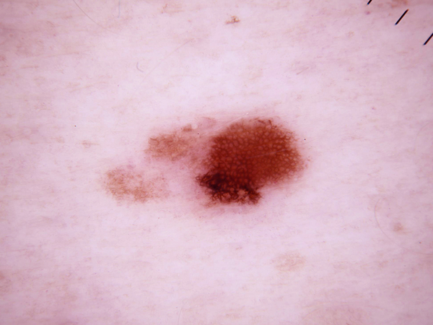
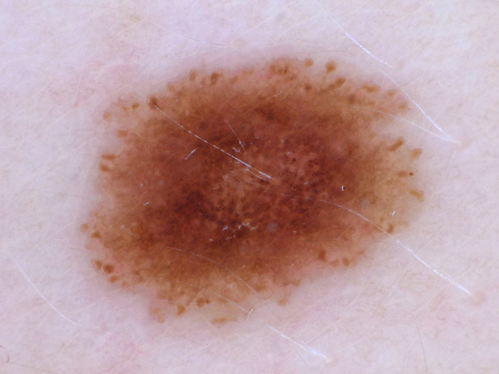
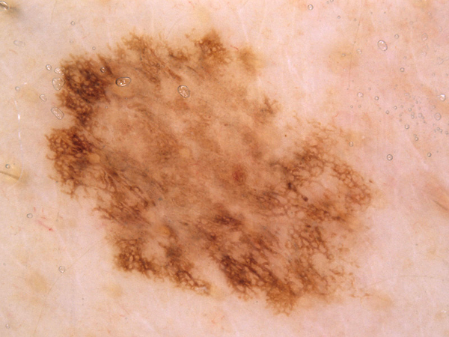
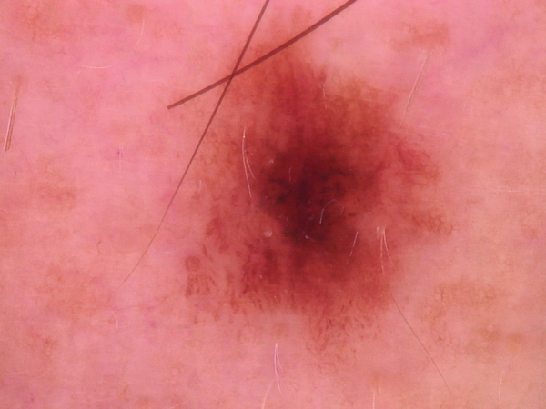
BASE PAPER DETAILS : DATASET SAMPLES

Slide 12
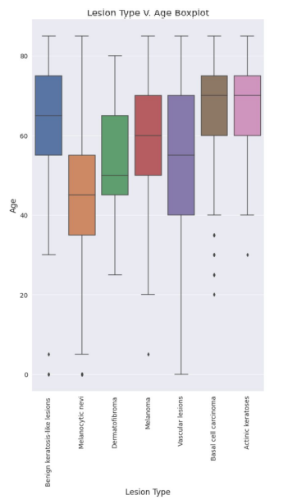
BASE PAPER DETAILS
5. Implementation Steps :
Pre-processing
Modelling
CONVOLUTIONAL NEURAL NETWORK
TRANSFER LEARNING
Performance Analysis

Slide 13
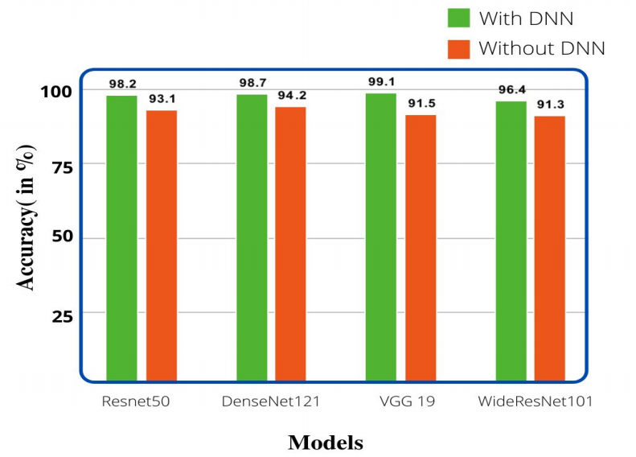
Base Paper Results
Classification Result :

Slide 14
CONCLUSION
The power of deep neural networks in the classifying dermatoscopic images of seven major skin lesions, which if used in the real world, can provide diagnosis which potentially could be life-saving.
After analysing all the 5 models, the most promising result was obtained using VGG-19 Network which delivered best accuracy
Using these modified networks, better visual diagnostic precision is obtained as compared to an expert or clinician.
The ease of implementation clearly exhibits the potential of these models being used in dermatoscopic systems and modern smartphones in the near future.

Slide 15
SELECTED REFERENCES
Atharva Jibhakate, Pranav Parnerkar, Sahil Mondal, Vastav Bharambe, Shamla Mantri, "Skin Lesion Classification using Deep Learning and Image Processing", 2021 IEEE
Amirreza Mahbod, Gerald Schaefer, Chunliang Wang, Rupert Ecker, Isabella Ellinger, "SKIN LESION CLASSIFICATION USING HYBRID DEEP NEURAL NETWORKS", 2019 IEEE.
Jianpeng Zhang, Yutong Xie, Yong Xia, Chunhua Shen, "Attention Residual Learning for Skin Lesion Classification", 2019 IEEE
Haroon Rashid, Asjid Tanveer, Hassan Aqeel Khan, "Skin lesion classification using GAN based data augmentation", 2019 IEEE.
Adekamni A. Adegun, Serestina Viriri, "FCN-Based DenseNet Framework for Automated Detection and Classification of Skin Lesions in Dermoscopy Images", 2020 IEEE

Slide 16

THANK YOU

